Slide 1
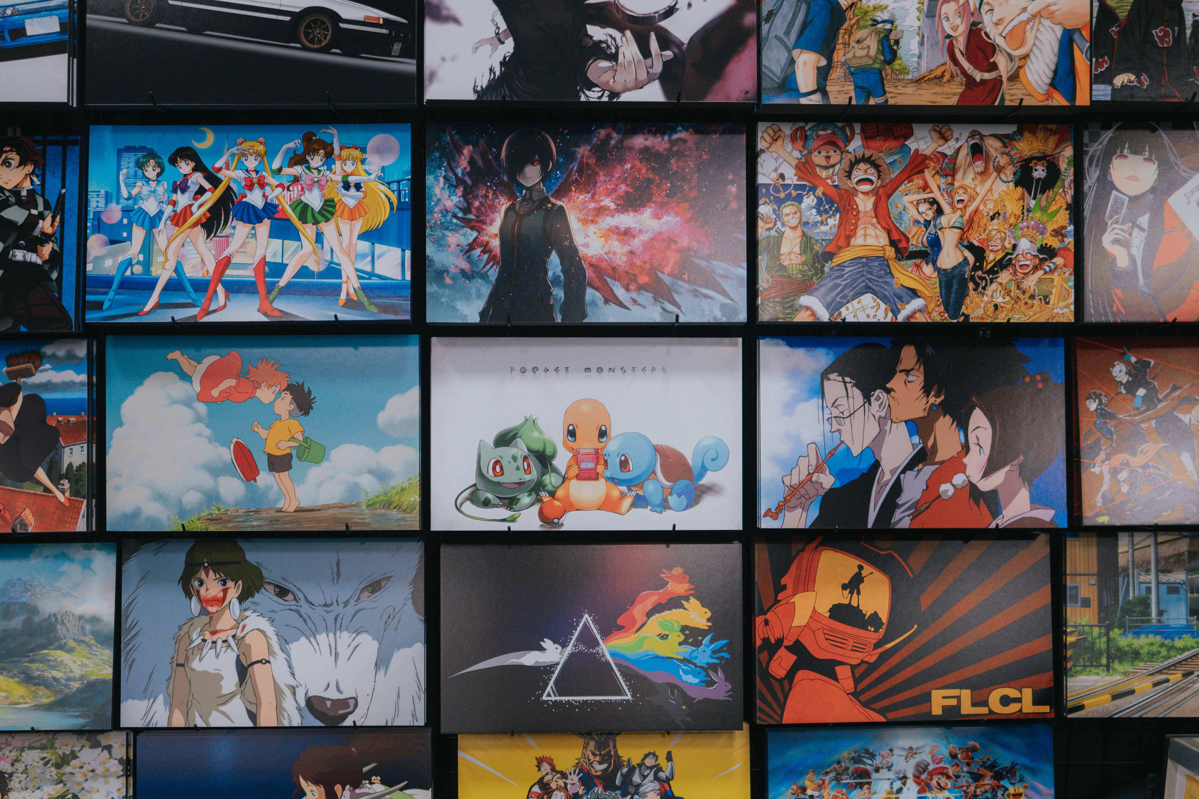
Anime Analysis Report
Insights and Trends in Anime Data

Slide 2

Objectives
Increase Awareness: Introduce anime to a broader audience in India.
Personalized Recommendations: Provide tailored anime suggestions based on individual preferences.
Highlight Hidden Gems: Showcase lesser-known yet amazing anime that deserve attention.

Slide 3

Methodology
Data Collection: Gather data on various anime titles, including genres, ratings, episodes, and descriptions.
Analysis: Use data visualization and statistical methods to analyze trends and popular genres.
Recommendation: Curate a list of anime recommendations based on the analysis.

Slide 4
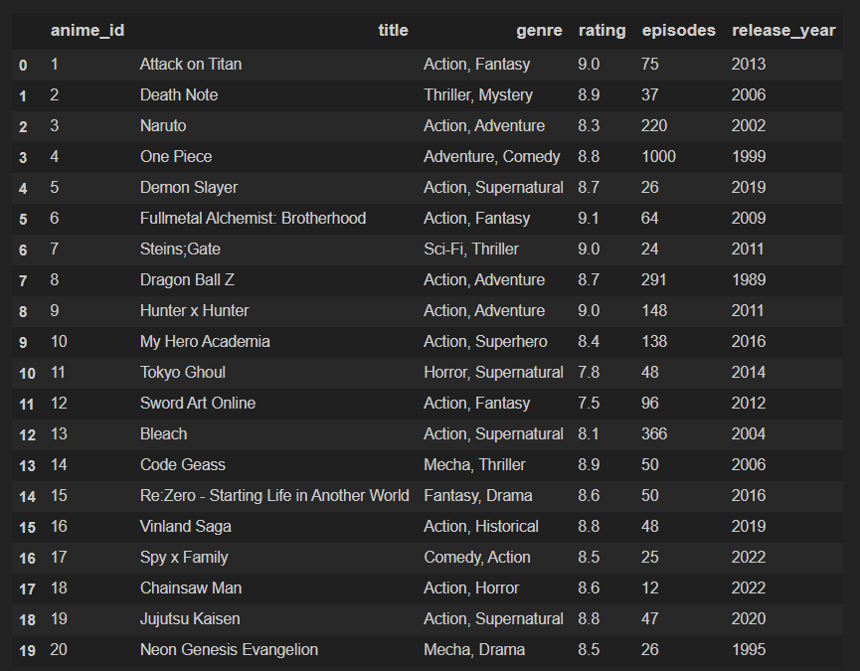
Introduction
This presentation provides an analysis of anime data from 2020 with some of 2025, covering rankings, categories, and trends.

Slide 5

Data Import & Cleaning
- Imported dataset using pandas
- Checked dataset shape, columns, and missing values
- Addressed inconsistencies and missing values

Slide 6
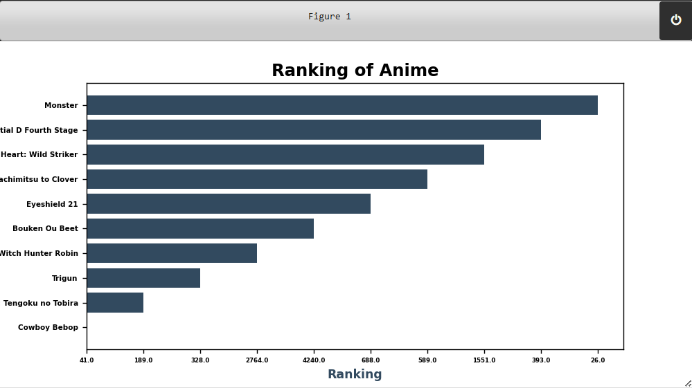
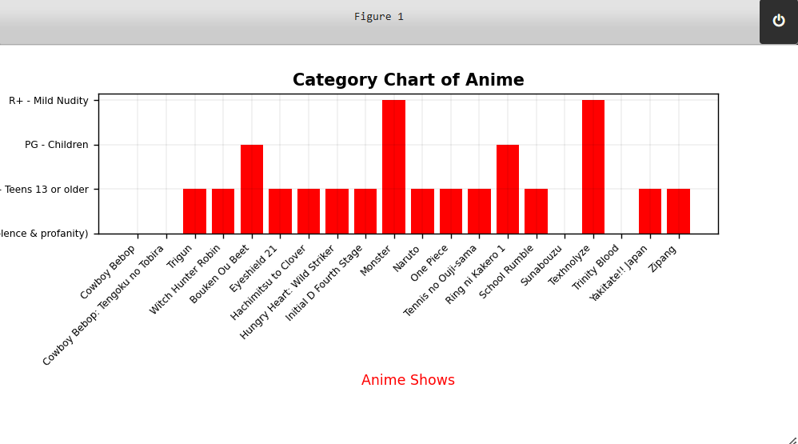
Exploratory Data Analysis (EDA)
- Analyzed anime categories and genres
- Identified top-ranked anime
- Compared TV series vs movies
- Examined anime based on manga adaptations

Slide 7
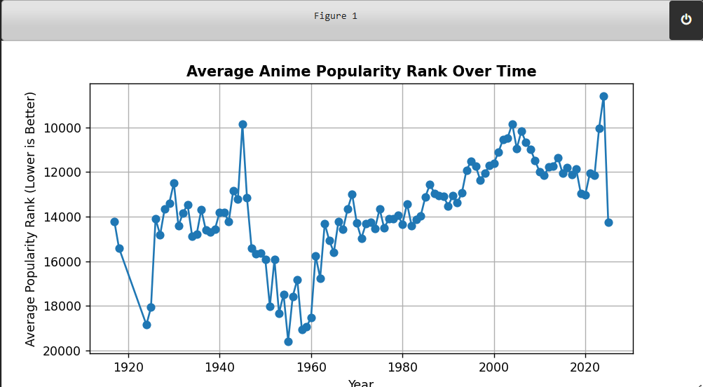
Visualizations
Charts and graphs were used to represent anime rankings, genre distributions, and comparisons.

Slide 8
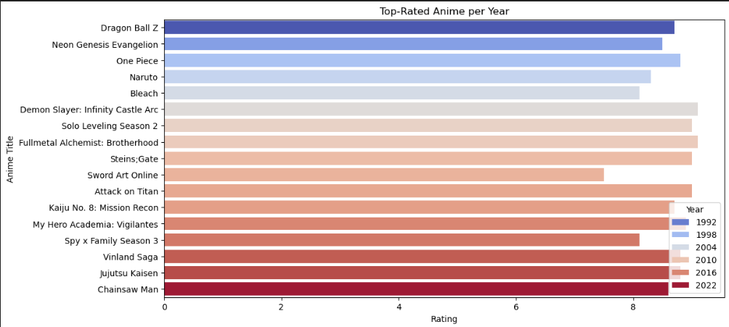
Top rated anime based on the years

Slide 9

Conclusion
In conclusion, anime is a rich and diverse form of entertainment that offers something for everyone. Through careful analysis and recommendations, we can help people discover and appreciate the depth of storytelling, unique art styles, and cultural insights that anime provides. By increasing awareness and providing personalized recommendations, we aim to foster a growing community of anime enthusiasts in India. This initiative not only promotes diverse entertainment options but also bridges cultural gaps and brings people together through shared interests.

Slide 10
Thank you for your attention, and I hope this analysis inspires you to explore the wonderful world of anime!

